Slide 1
Modern Theming
In Angular and Material

Slide 2

This lecture is about
not
AI
Angular Material
Angular… actually

Slide 3
This lecture is about
yes
Demo app with chat bots
AI
Angular Material
The new approach of to theming
V20 of
Angular… actually

Slide 4

“Angular Material” is known for
Problematic code
Hard to customize
Breaks every few versions
But why?

Slide 5
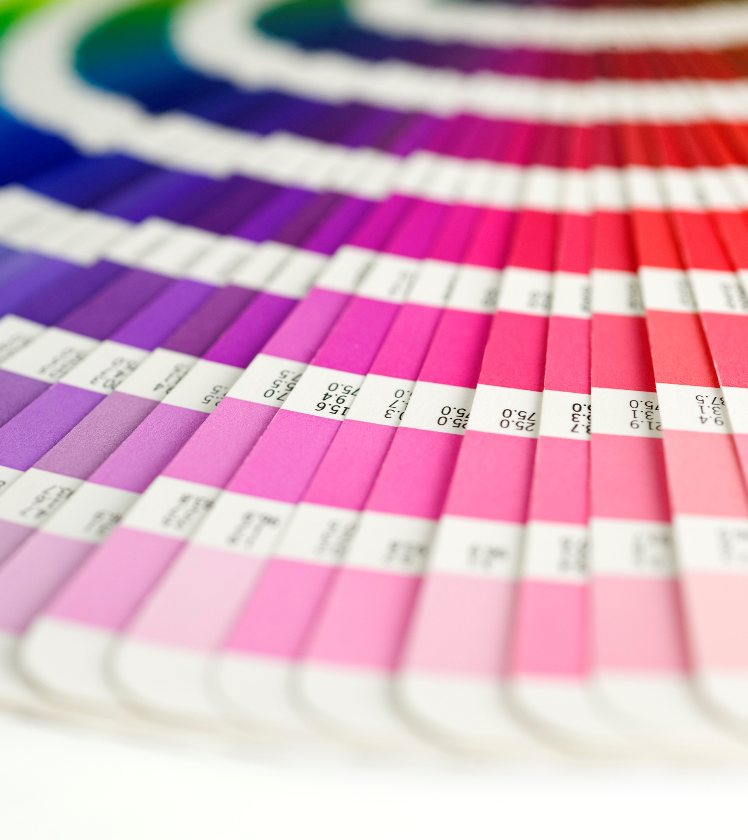
Theming
Consistent Graphical Concept
Reuse colors, fonts, icons

Slide 6
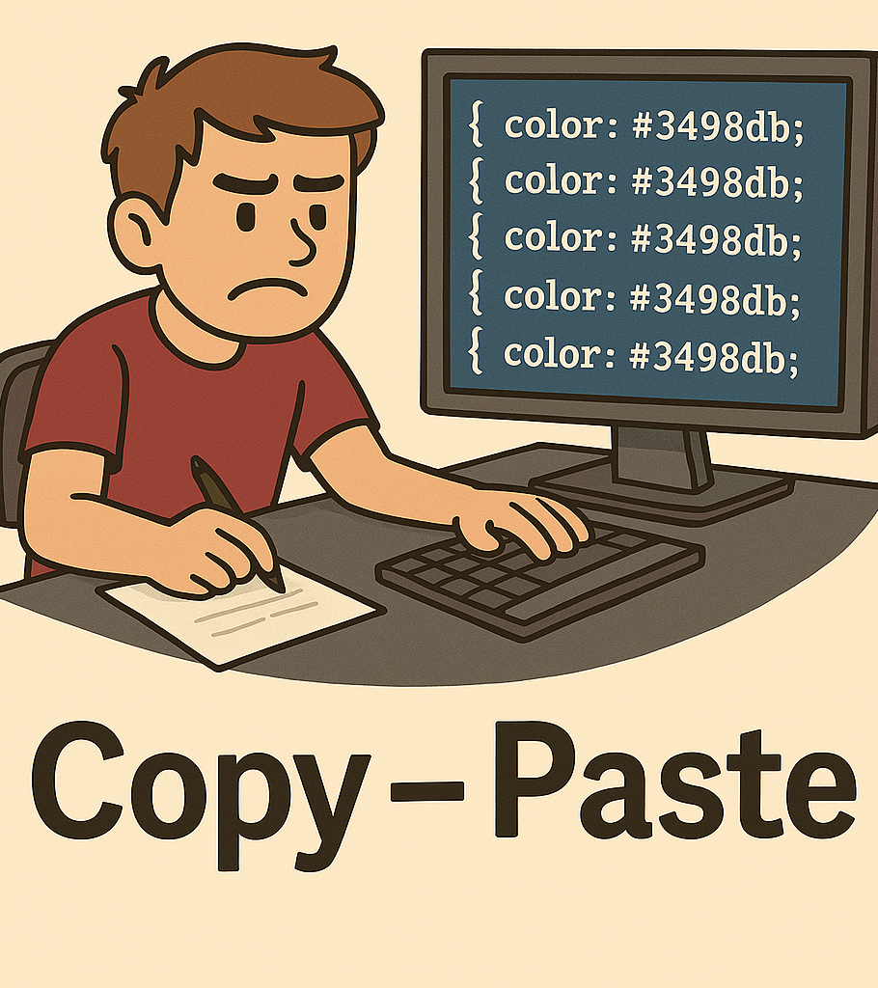
CSS Challenges
No “variables”
No “constants”
No “functions”
* at least not in 2015

Slide 7

Sass to the rescue?
It has Variables, Constants, Functions
But… It’s only in Compile time
It generates the same “bad” CSS
This Photo by Unknown Author is licensed under CC BY-SA

Slide 8
styles.scss
@use '@angular/material’ as mat;
@include mat.core();
$my-primary: mat.define-palette(mat.$indigo-palette);
$my-accent: mat.define-palette(mat.$pink-palette);
$my-warn: mat.define-palette(mat.$red-palette);
$my-theme: mat.define-light-theme((
color: (
primary: $my-primary,
accent: $my-accent,
warn: $my-warn,
),
typography: mat.define-typography-config(),
density: 0,
));
@include mat.all-component-themes($my-theme);

Slide 9
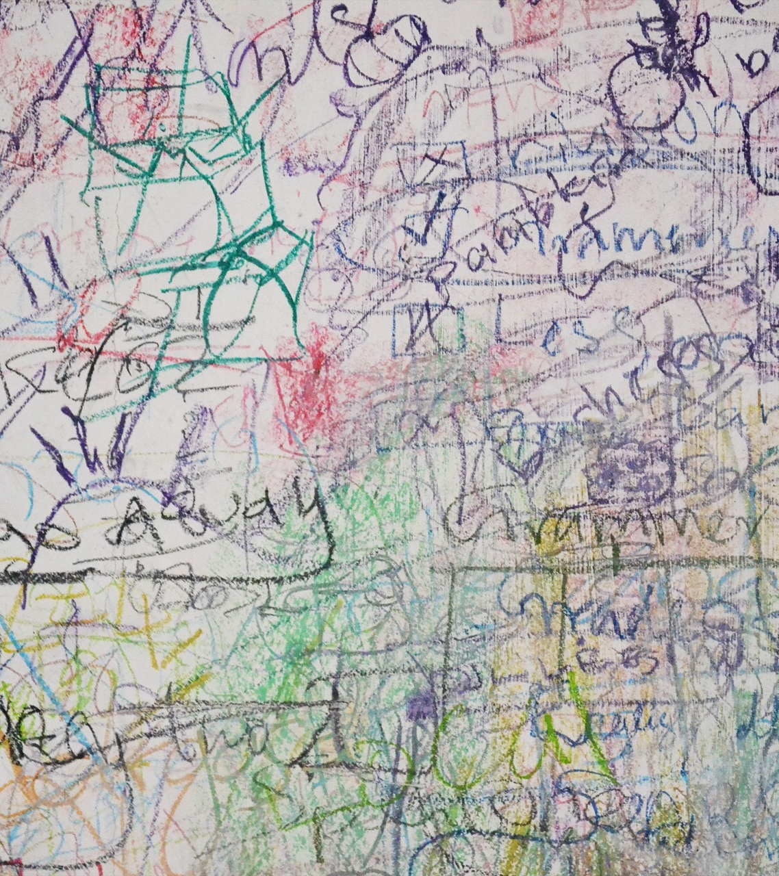
Why like this?

Slide 10
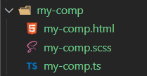
my-comp.scss
:host {
background-color: $primary-color;
}
You are an Angular Component Library Developer
You create component SCSS files
And need to use a variable the user defines
In his styles.scss How do you get the $primary-color variable?

Slide 11
_theme.scss
@mixin my-comp-style($primary-color) {
:host {
background-color: $primary-color;
}
}
Provide the styling as mixin Accept the theme colors as paramerter
Yack!

Slide 12
styles.scss
@use '@angular/material’ as mat;
@include mat.core();
$my-primary: mat.define-palette(mat.$indigo-palette);
$my-accent: mat.define-palette(mat.$pink-palette);
$my-warn: mat.define-palette(mat.$red-palette);
$my-theme: mat.define-light-theme((
color: (
primary: $my-primary,
accent: $my-accent,
warn: $my-warn,
),
typography: mat.define-typography-config(),
density: 0,
));
@include mat.all-component-themes($my-theme);

Slide 13

Custom Properties
--my-color: magenta;
background: var(--my-color);

Slide 14
CSS consists of two parts.
Property Value Engine
Visual Renderer
Specifity
Cascading
Layouts
Colors
Effects
Animations
Inheritance
Selectors

Slide 15

css-vars.css
css-vars.css
/* Custom properties */ :root { --my-prop: 50; --my-color: magenta; }
/* Custom properties */ h1 { color: var(--my-color); text-decoration: var(--my-color) underline; }

Slide 16
Relative Color Syntax
background: hsl(from blue h s calc(l * 0.8));

Slide 17
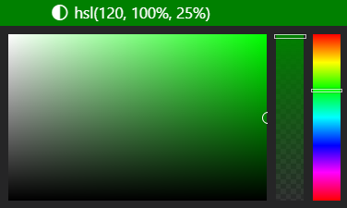
HSL
Hue
Choose the base color on the color wheel
Saturation
Choose how intense you want it
Lightness
Choose how bright you want it
From 0% (light’s off – black) to 100% (light’s fully on, bright)
From 0 degrees to 360
From 0% (grayscale) to 100% (fully saturated)
Hue, Saturation, Lightness

Slide 18
Mixing Colors
background:
color-mix(in srgb, blue, white 50%);

Slide 19
Color Schemes
Hello World
color-scheme: light
Hello World
color-scheme: dark

Slide 20
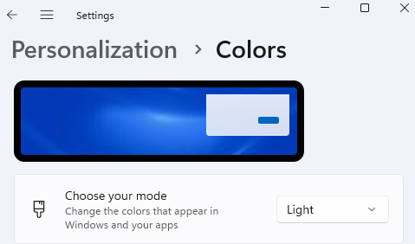
Color Schemes
color-scheme: light dark; // by system

Slide 21
Mixing Colors
color-scheme: light; background:
light-dark(lightblue, darkblue);
color-scheme: dark; background:
light-dark(lightblue, darkblue);

